Slide 1

ANALYSIS ON YOUTUBE TRENDING VIDEOS
Batch Members: Supervisor:
T VENKATA SAI SATHVIK (2010030361) Mr. Chanda Raj Kumar
NIHAL AGARWAL (2010030413) Assistant Professor
JAIDEEP SHARMA (2010030374)
SHAIK ABDUL SHAAN (2010030153)

Slide 2
Abstract
In this modern era, many users are addicted to YouTube which is available both as application and through website. In detail, YouTube is a content sharing platform through the means of video in any format which allows users to watch or share any specific video with anyone.
Usually there are three genres of content, that goes trending on YouTube, ranging from educational, entertainment and informative. Generally, when it comes to the entertainment genre there are users who would like to see gaming, music, short videos and many more.

Slide 3
Abstract
Students also frequently use YouTube for their study purposes to establish a good secure knowledge. YouTube is not limited to a particular age group, caste, creed or country, anyone can use it throughout the world.
We provide analysis through data science to determine videos which are trending based on number of likes, views, and comments.

Slide 4
Introduction
YouTube is a widely used and famous online video platform in the world today. YouTube has a list of trending videos that is updated constantly.
Companies and businesses using social media and digital platform can also use this analysis to boost their growth in business by publishing videos or sponsoring appropriate channels at right time.

Slide 5
Introduction
Analysing these trending videos can give content creators greater perspective and Knowledge for increasing their popularity and brand of their channels.
Data visualization is a key component to business and data analytics, allowing analysts in businesses to create tools such as dashboards for business executives. Various software packages allow businesses to create these tools in order to manipulate data for making informed business decisions.

Slide 6
Literature Survey
Title of the Paper | Description | Publication Details | Web Link
Algorithm of Trending Videos on YouTube Analysis using Classification, Association and Clustering. | Finding the highest positive rated video by analyzing the different factors of the video such as views, likes, comments and dislikes by the data mining. | Johanes Fernandes Andry, Stefan Azriel Reynaldo, Kevin Christianto, Francka Sakti Lee, Julia Loisa, Aman Budi Manduro. Published Year:- 2021 | 2021 International Conference on Data and Software Engineering (ICoDSE) DOI: 10.1109/ICoDSE53690.2021.9648486.
Analysis on YouTube Trending Videos | They used three algorithms to analyse the trending videos and non trending videos such as classification, regression, and clustering and similarity matching. They analysed the best time to upload videos. | Swati Gayakwad, Rajas Patankar, Dashrath Mane. Published Year:- 2020 e-ISSN: 2395-0056, p-ISSN: 2395-0072. | International Research Journal of Engineering and Technology (IRJET), Volume: 07 Issue: 08 | Aug 2020 .

Slide 7
Literature Survey
Trending Videos: Measurement and Analysis. | They employed Granger Causality (GC) with significance testing to conduct this analysis. The directional-relationship analysis provides a deeper insight onto the viewer- ship pattern of different categories of trending videos. | Iman Barjasteh, Ying Liu, Hayder Radha. Published Year:- 2014 | Cornell University, https://arxiv.org/abs/1409.7733
Youtube Trending Videos: Boosting Machine Learning Results Using Exploratory Data Analysis. | They performed an exploratory data analysis (EDA) on all its aspect to get data insights and used statistics to find similarities between them to understand viewing pattern of different video categories. | Sana Khanam, Safdar Tanweer, Syed Sibtain Khalid. Published Year:- October 2021 | The Computer Journal, bxab142, https://doi.org/10.1093/comjnl/bxab142

Slide 8
Literature Survey
Understanding Digital Ethnography: Socio-computational Analysis of Trending YouTube Videos | Enhanced the dataset obtained from Kaggle by adding the description of the video, date the channel was created, and the number of subscribers of the channel, using YouTube API. | Muhammad Nihal Hussain, Serpil Tokdemir, Samer Al-khateeb, Kiran Kumar Bandeli, and Nitin Agarwal Published Year:- 2018 | http://sbp-brims.org/2018/proceedings/papers/latebreaking_papers/LB_14.pdf.
Predictive analysis of YouTube trending videos using Machine Learning | The study performs a comparative analysis of a number of classification models namely Random Forest, SVM, Decision Tree, Logistic Regression and Gaussian Naïve Bayes, to determine which model suits better for predicting the number of days a video will take to get trending | Aakash Ashok Niture Supervisor: Mr. Pierpaolo Dondio Published Year:- january 2021 | https://esource.dbs.ie/bitstream/handle/10788/4260/msc_niture_aa_2021.pdf?sequence=1&isAllowed=y.

Slide 9
Existing System
In the existing systems, we see that
The analysis is done on dislikes, likes, views, but now YouTube has removed the concept of dislikes, due to which the analysis can go wrong.
Another system analyses and shows the best time to upload the videos, which will again not give the trend analysis.
The analysis using Granger causality will show the viewership trend of the type of video category the viewers are interested.
In another analysis pattern, they have updated the dataset and added another component on which the analysis would differ.
Just comparative analysis of the use of the model for analysis has been discussed, but no proper analysis has been done for the YouTube Videos.

Slide 10
Proposed System
Firstly, we detect the outliers using the quantile method, for which we have to convert the views and likes in maximum range till 10^5, after this by using quantile method, we find the threshold for videos and likes for video to be on trending, by using the maximum threshold we extract the final dataset.
After that, we do the bokeh visualization for the Youtube trending videos, for this we convert the likes and views in the form of log values using Numpy, then we make use of glyph data points where it is plotted based on channel name, views and likes. Many videos have categories divided into sub-categories, so we have to group them and check which category has maximum number of trending videos.

Slide 11
Proposed System
Now, we differentiate it into data frames for corresponding category and put all data in it, using the data frame we get the highest number of likes, views and comments for getting it as trending, trends can be set using many factors such as, capitalized titles, length of title.
Also making use of histograms and pie charts for getting the maximum count of likes and minimum count of likes. Analysis on the bar plot graph is done to see which channel has highest number of videos and, highest number of videos and whether the videos are on trending.

Slide 12
Methodology
We have collected the dataset from Kaggle platform, where we have found benchmark dataset of India and US. Here we can find the link to the dataset used Trending-YouTube-Scraper .
Then we import multiple libraries available in python language, mentioned in tools used. We go for detecting the outliers of the videos based on the views and likes. Based on the output a cleaned dataset is obtained which contains the data which lies under the outliers maximum threshold.
We plot the bokeh graph for the obtained dataset using glyph plots and understand the trending video update.

Slide 13
We next group videos based on the category-id’s
# ID -> Category Name # 1 --> Film and animation # 2 --> Autos and vehicles # 10 --> Music # 15 --> Pets and Animals # 17 --> Sports # 19 --> Travel and Events # 20 --> Gaming # 22 --> People and Blogs # 23 --> Comedy # 24 --> Entertainment # 25 --> News and politics # 26 --> How to style # 27 --> Education # 28 --> Science and Technology # 29 --> Non-profits and Activism
Here we have some marks for the categories which will be used for distinguishing the videos and finding the trending videos.

Slide 14
Now we go for other factors which decides the trends of the video, that is we got for the capitalized words in the video title, we get to know that 80% videos for the selected dataset have the capitalized words, using which we can analyse the length of the titles of videos.
We plot the histogram of the videos with titles of length above 100, so that we can include the video in the trending list.
From another visualization we get to know that length of video titles and number of views are not inter-related. By analysing the views, we get to know that a video is trending if it has 5 millions and more views. After that we go for videos with 25 million views and more, by which we get a appropriate analysis based on views.
Now we go for trend analysis by using the likes count, we plot a histogram for videos with likes equal or greater than 100,000 likes.

Slide 15
By using the channel name, video views, video likes, we plot the bokeh graphs, the glyphs on the graph show the trending video title, channel name, views for the video and by which we get the analysis of the trends of the videos users is more likely to watch.

Slide 16
Algorithm/Techniques/Tools Used
We have implemented the analysis using python programming language and Jupyter notebooks.
We have used many libraries available for data visualization, data scraping, analysis in python.
Use of data visualization has lead to creation of data plots or diagrams which can lead to better analysis of trends in pictorial form
List of libraries used:
Pandas
NumPy
Matplotlib
Seaborn
Bokeh
Outliers
Jupyter Notebooks is a client-server application used for running notebook documents in browser.

Slide 17
Software and Hardware Requirements
HARDWARE REQUIREMENTS:
1. Intel(R) Core(TM) i5-10300H CPU @ 2.50GHz 2.50 GHz
2. 8.00 GB RAM or higher.
3. 64 Bit operating system or higher.
4. 1 TB Hard free drive space.

Slide 18
Software and Hardware Requirements
SOFTWARE REQUIREMENTS:
1. Operating System: Windows 10
2. Web Browser: Brave/ Google Chrome
3. Python programming language
4. Jupyter notebooks for python

Slide 19
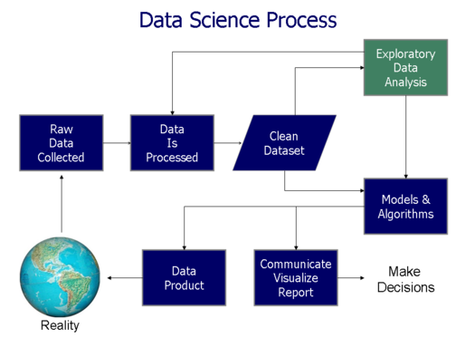
Block Diagram/Architecture

Slide 20
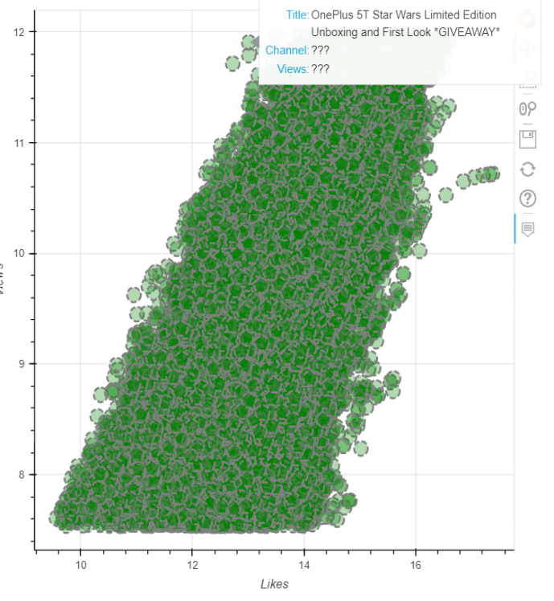
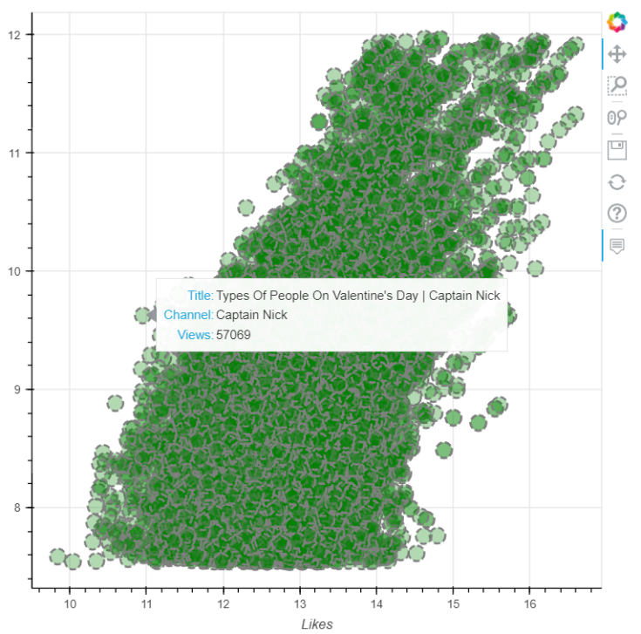
Results
Bokeh output without channel names and views count on each point and based on likes
Bokeh output with channel names and views count on each point and based on likes

Slide 21
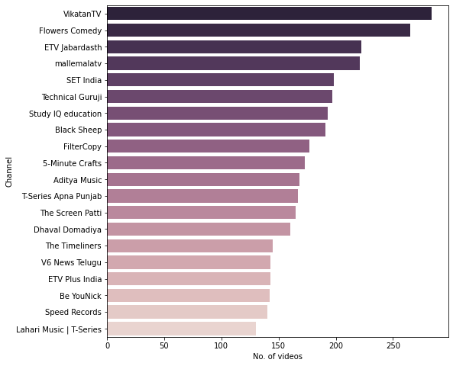
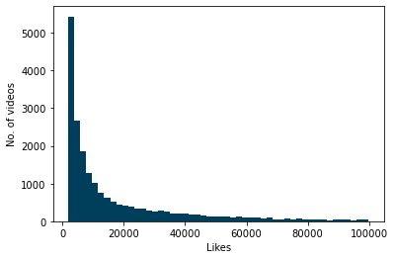
Results
Number of videos uploaded by the channel
Number of videos with like count from 0 to 100000

Slide 22
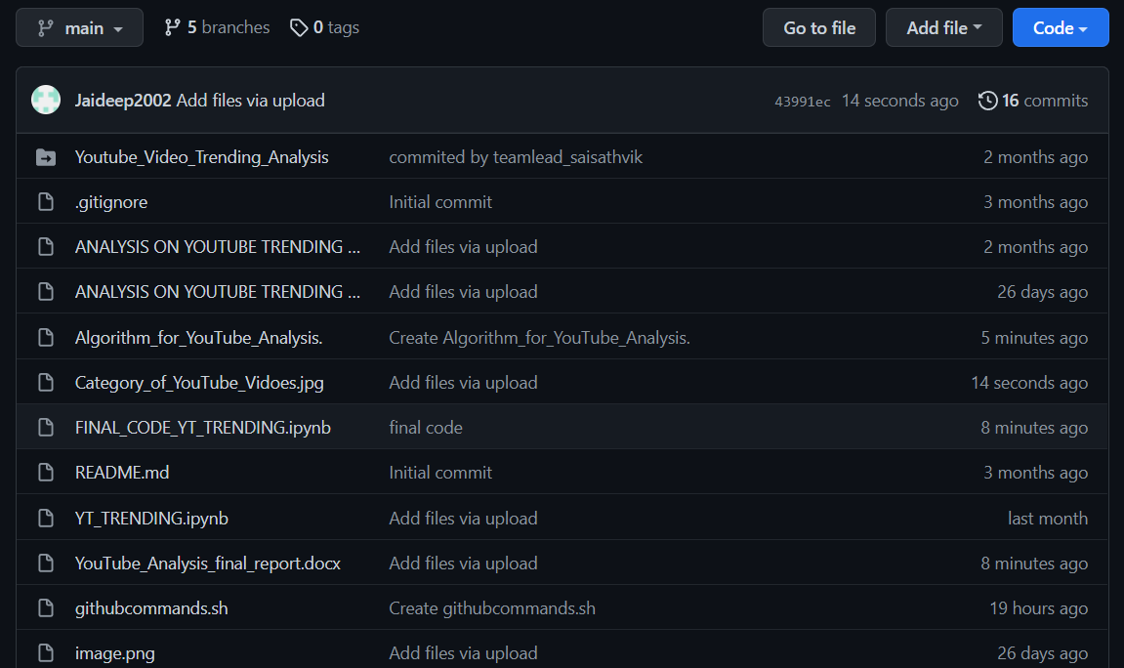
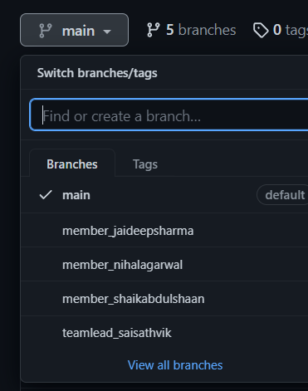
Github Setup

Slide 23
Applications
Our Project is finding the trending videos on YouTube, which can be used by content creators more specifically the youtubers who regularly upload videos on their channel.
This can be applied by them for greater perspective and Knowledge for increasing their popularity and brand of their channels.
This can also be used by many companies and businesses using social media and digital platform can also use this analysis to boost their growth in business by publishing videos or sponsoring appropriate channels at right time.
Data visualization of the trends of videos can lead to better understanding of the content needed by the viewers and can lead to better content creation.

Slide 24
Conclusion
The above implementation shows analysis of the YouTube videos, which is based on the different parameters such as category name, length of the title, views, likes. If a person watches a video, the first thing he notices is the above mentioned parameters. The data visualization on these parameters gives us the appropriate analysis of videos, which helps the viewer to make a choice to watch the video or skip it. It will also help the channel owner to make videos based on the interest of the viewer. The graphs and tables generated gives a proper remark on the video.

Slide 25
Future Scope
The above work shows the analysis of the trending videos on YouTube. In the future, we shall try to implement a user interface for making it interactive for the user. Which will make it more comfortable for visualization.

Slide 26
References
2021 International Conference on Data and Software Engineering (ICoDSE), 3-4 Nov. 2021, DOI:10.1109/ICoDSE53690.2021.9648486.
International Research Journal of Engineering and Technology (IRJET), Volume: 07 Issue: 08 | Aug 2020 . e-ISSN: 2395-0056, p-ISSN: 2395-0072.
The Computer Journal, bxab142, https://doi.org/10.1093/comjnl/bxab142
Cornell University, https://arxiv.org/abs/1409.7733.
https://esource.dbs.ie/bitstream/handle/10788/4260/msc_niture_aa_2021.pdf?sequence=1&isAllowed=y
http://sbp-brims.org/2018/proceedings/papers/latebreaking_papers/LB_14.pdf

Slide 27
Thank You

